Slide 1
CREATIVE SOLUTIONS PROJECT PROPOSAL
Here is where your presentation begins

Slide 2
CONTENTS OF THIS TEMPLATE
Here’s what you’ll find in this Slidesgo template:
A slide structure based on a project proposal, which you can easily adapt to your needs. For more info on how to edit the template, please visit Slidesgo School or read our FAQs.
An assortment of graphic resources that are suitable for use in the presentation can be found in the alternative resources slide.
A thanks slide, which you must keep so that proper credits for our design are given.
A resources slide, where you’ll find links to all the elements used in the template.
Instructions for use.
Final slides with:
The fonts and colors used in the template.
A selection of illustrations. You can also customize and animate them as you wish with the online editor. Visit Storyset to find more.
More infographic resources, whose size and color can be edited.
Sets of customizable icons of the following themes: general, business, avatar, creative process, education, help & support, medical, nature, performing arts, SEO & marketing, and teamwork.
You can delete this slide when you’re done editing the presentation.

Slide 3
TABLE OF CONTENTS
01
04
02
05
03
06
ABOUT THE PROJECT
You can describe the topic of the section here
SNEAK PEEK
REQUIREMENTS
You can describe the topic of the section here
You can describe the topic of the section here
PROJECT STAGES
PROJECT GOALS
You can describe the topic of the section here
You can describe the topic of the section here
OUR TEAM
You can describe the topic of the section here

Slide 4
01
OUR COMPANY
You can enter a subtitle here if you need it

Slide 5
OUR COMPANY
You can give a brief description of the topic you want to talk about here. For example, if you want to talk about Mercury, you can say that it’s the smallest planet in the entire Solar System

Slide 6
WHAT WE ARE WORKING ON
MERCURY
SATURN
Mercury is the closest planet to the Sun
It’s composed of hydrogen and also helium
VENUS
Venus is the second planet from the Sun

Slide 7
ABOUT THE PROJECT
Do you know what helps you make your point clear? Lists like this one:
They’re simple
You can organize your ideas clearly
You’ll never forget to buy milk!
And the most important thing: the audience won’t miss the point of your presentation

Slide 8
WHOA
This can be the part of the presentation where you introduce yourself, write your email…

Slide 9
“This is a quote, words full of wisdom that someone important said and can make the reader get inspired.”
—SOMEONE FAMOUS

Slide 10
MAJOR REQUIREMENTS
MERCURY
Mercury is the closest planet to the Sun and the smallest one
VENUS
Venus is the second planet from the Sun. It’s terribly hot

Slide 11
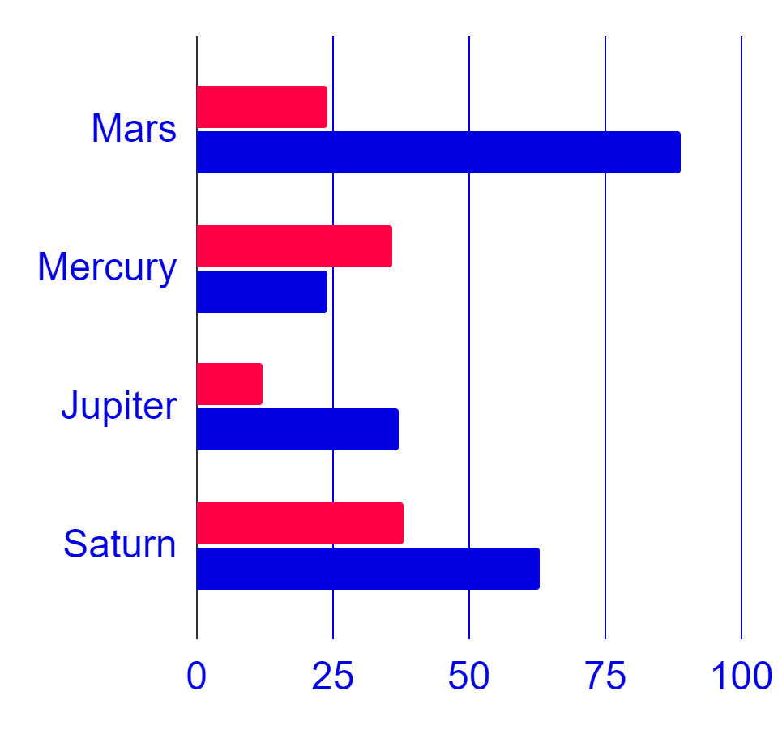
BUDGET
MERCURY
$ 465,789
Mercury is the closest planet to the Sun and the smallest one
$ 523,657
Venus
Earth
Jupiter is a gas giant and the biggest planet of them all
Follow the link in the graph to modify its data and then paste the new one here.
For more info, click here

Slide 12
AWESOME WORDS

Slide 13
PROJECT GOALS
MERCURY
JUPITER
NEPTUNE
Mercury is the smallest planet
Jupiter is the biggest planet
Neptune is the farthest planet
MARS
VENUS
SATURN
Mars is a very cold place
Venus is the second planet
Saturn is the ringed one

Slide 14
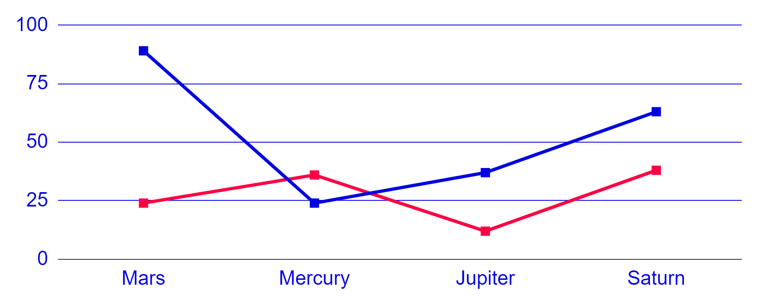
PREDICTED RESULTS
2,890
$20,000
100
Follow the link in the graph to modify its data and then paste the new one here. For more info, click here
New clients next year
Expected income in 2021
New employees next year

Slide 15
PROJECT BLUEPRINT
MERCURY
JUPITER
Mercury is the smallest planet
Jupiter is the biggest planet
MARS
VENUS
Mars is a very cold place
Venus has a beautiful name

Slide 16
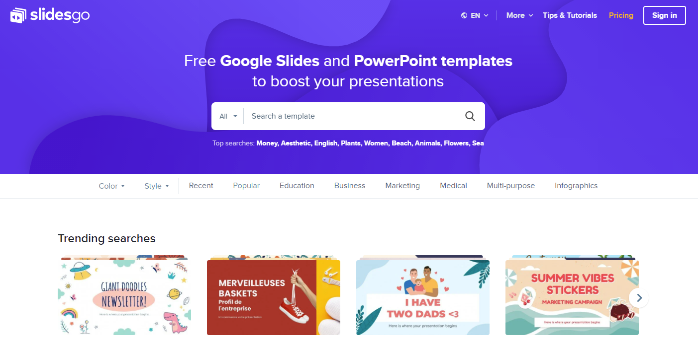
SNEAK PEEK
MERCURY
You can replace the image on the screen with your own work. Just delete this one, add yours and center it properly

Slide 17
PROJECT STAGES
STAGE 1
It’s a cold place. The planet is full of iron oxide dust
STAGE 2
Mercury is the smallest one in the Solar System
STAGE 3
Saturn is composed mostly of hydrogen and helium
STAGE 4
Venus is the second planet from the Sun. It’s hot

Slide 18
TIMELINE
MERCURY
JUPITER
Mercury is the smallest planet
Jupiter is the biggest planet
DAY 1
DAY 2
DAY 3
DAY 4
MARS
NEPTUNE
Mars is a very cold place
Neptune is the farthest planet

Slide 19
OUR PARTNERS
JUPITER
MERCURY
Jupiter is the biggest planet
Mercury is a small planet

Slide 20
THIS IS AN INFOGRAPHIC
MERCURY
Mercury is the smallest planet
JUPITER
Jupiter is the biggest planet
MARS
Mars is a very cold place
NEPTUNE
Neptune is the farthest planet

Slide 21
OUR TEAM
JENNA DOE
Mercury is the closest planet to the Sun
JOHN GREEN
Venus is the second planet from the Sun
MAX SMITH
It’s composed of hydrogen and helium

Slide 22
THIS IS A TABLE
 | MASS (EARTHS) | DIAMETER (EARTHS) | SURFACE GRAVITY (EARTHS)
Mercury | 0.06 | 0.38 | 0.38
Mars | 0.11 | 0.53 | 0.38
Saturn | 95.2 | 9.4 | 1.16

Slide 23
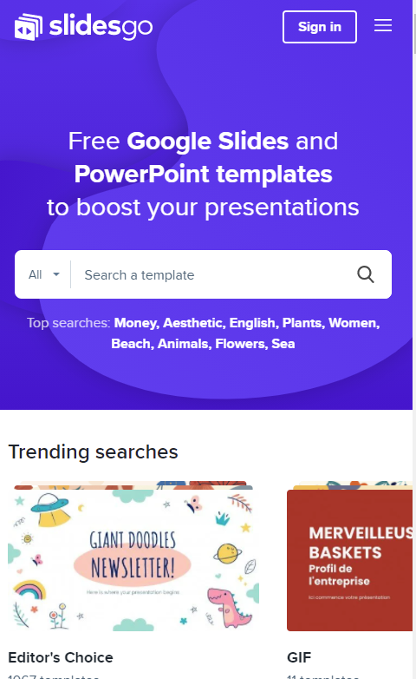
PHONE MOCKUP
MERCURY
You can replace the image on the screen with your own work. Just delete this one, add yours and center it properly

Slide 24
THANKS
facebook.com/Freepik
Do you have any questions?
addyouremail@freepik.com
+91 620 421 838
yourcompany.com
@Freepik_Vectors
company/freepik-company
Please keep this slide for attribution

